Slide 1

Keller-Williams
Family Check-In
A Web Application for enhancing and recording Keller-Williams realty interactions
By Patrick Bailey, Josh Garnick, and Aaron Flager

Slide 2

The Client
Largest real estate franchise in North America
Family first company
Focused on new broker training

Slide 3
The Problem
Find a way to update a process that is currently being done on paper
Keeping track of broker training
Update the staff on the progress of new brokers

Slide 4
Approach
Combine our cumulative knowledge as well as integrate outside experience
Skills from LCC:
MVC architecture
Visual Studio
Microsoft Azure
Notes:
Josh section slide 1/

Slide 5
Approach
Experience outside of LCC:
Bootstrap
JQuery
Template language
Notes:
Josh section slide 1/

Slide 6
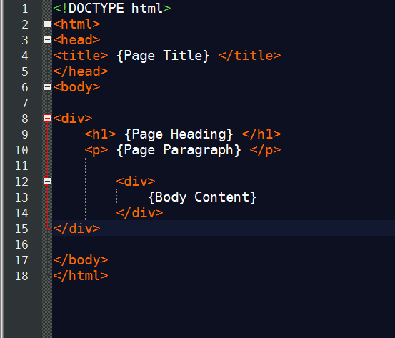
Approach
DRY code
Reduce overall HTML
Easier to read
Less potential for errors
Notes:
Josh section slide 1/

Slide 7

Each team member’s contributions to the project
Week-to-week milestones or “sprints”
Issues and task assignments
Version control
Minutes from our weekly meetings
Interactions with the client
Notes:
Josh section slide 1/6

Slide 8
Approach
Design Principles:
Functionality first
Scalable
Easy to use
DRY code
Notes:
Josh section slide 1/

Slide 9
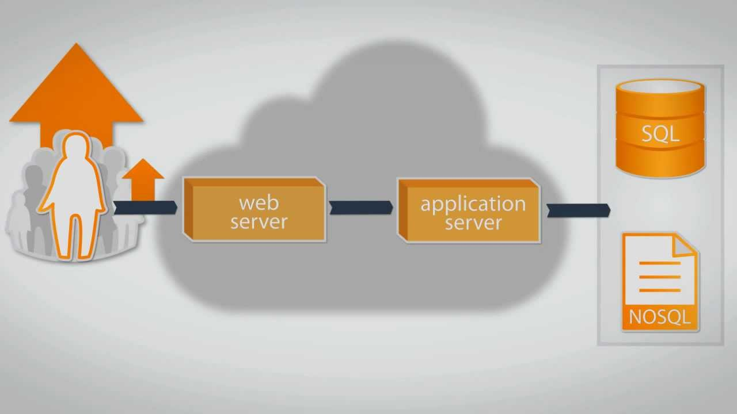
Approach
Scalable
Not knowing precise numbers means that we will have to design the system to work well with at least 300 brokers in mind.
Notes:
Josh section slide 1/

Slide 10
Concerns
Implementing mass email service
Adaptable scaling for the future
Advanced security
Performance after expansion

Slide 11





Concerns
ASP.NET or DOTNET version changes
Guiding client to web hosting service

